Slide 1
DAV6100:
Data Analysis of Public Safety
(Traffic Violation)
Group 2:
Ashish Bachuwar
Mahanth Dasari
Minjae Lee

Slide 2
Agenda
Overview
Project Requirements
Data Profile
Conceptual Architecture
Demo
Project Milestones & Timeline
Team Responsibilities
Challenges
Lessons Learned

Slide 3




Overview
In 2018, about 1.5 million people were fined in New York City for traffic violations, which reflects the high traffic density and strict law enforcement in the city.
By analyzing the violation data, we identified the most common code of violations, reasons for violations, and distribution of violations over the months and days of the week.
With the help of data management and visualization techniques, we extracted insights from the ticket data, such as the age group of violators and which courts handle the majority of cases.
By comparing the data from different sources, such as motor vehicle crashes and violation codes, we identified patterns and correlations that can be used to improve traffic safety in the city.
Many data sources
Data Warehouse
Data Visualization

Slide 4
Project Requirements
1. Design, Document, & Plan
3. Test the Solution
Develop a conceptual design architectures
Develop data flow diagrams and data models
Define analytics concepts with bus matrix
Define ETL Instructions
Define data attributes
A prototype is to be test
Break-testing and optimization of the database may be necessary (use of indexes)
Ensure that error-handling scenarios are considered
2. Develop and Build
4. Present and Deliver
Develop the warehouse solution using Amazon Web Services as the platform
Include two data structures:
Structured dataset
Semi/Unstructured dataset
Integrations:
Batch/Migration
Real-time
Data Visualization
Code Repository (GitHub)
Deliver an executive presentation
Demo the architectural components
Demo the visualizations in a data visualization platform like Tableau

Slide 5


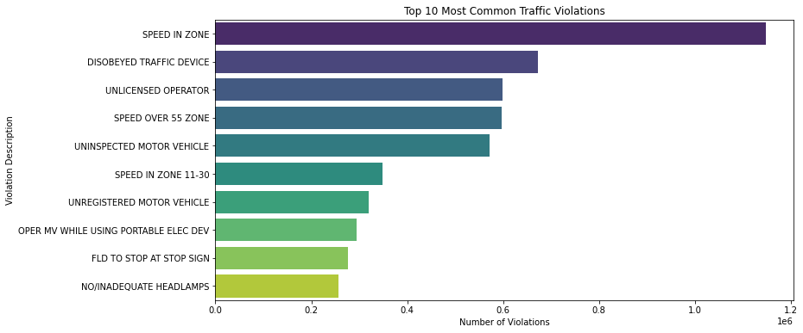
Data Profile: Dataset 1
Instructions:
Use this slide for every dataset you profile. You should summarize your datasets in these slides using basic statistics and information about the source and provenance of the data.
Dataset Summary
Source of Information | DATA.NY.GOV
Number of Records | 10.8 Million
Frequency of updates | Annually
Data type and structure | Numeric & Categorical
Number of columns | 11
Granularity | Individual tickets
Descriptive Statistics

Slide 6
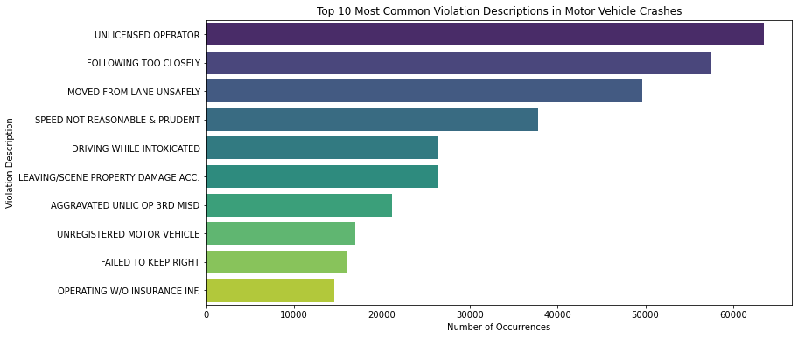
Data Profile: Dataset 2
Instructions:
Use this slide for every dataset you profile. You should summarize your datasets in these slides using basic statistics and information about the source and provenance of the data.
Dataset Summary
Source of Information | DATA.NY.GOV
Number of Records | 556K
Frequency of updates | Annually
Data type and structure | Numeric & Categorical
Number of columns | 4
Granularity | Crash Event
Descriptive Statistics

Slide 7
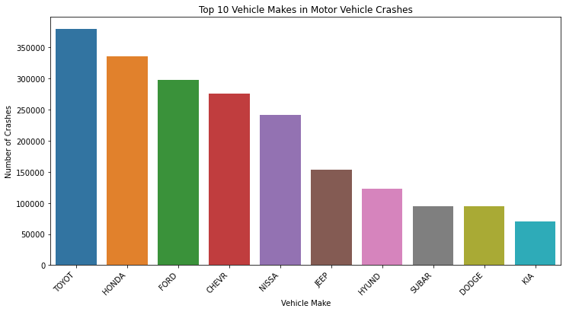
Data Profile: Dataset 3
Instructions:
Use this slide for every dataset you profile. You should summarize your datasets in these slides using basic statistics and information about the source and provenance of the data.
Dataset Summary
Source of Information | DATA.NY.GOV
Number of Records | 4.74 Million
Frequency of updates | Annually
Data type and structure | Numeric & Categorical
Number of columns | 15
Granularity | Individual in Crash
Descriptive Statistics

Slide 8
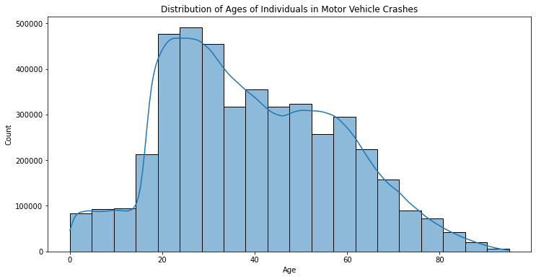
Data Profile: Dataset 4
Instructions:
Use this slide for every dataset you profile. You should summarize your datasets in these slides using basic statistics and information about the source and provenance of the data.
Dataset Summary
Source of Information | DATA.NY.GOV
Number of Records | 3.66 Million
Frequency of updates | Annually
Data type and structure | Numeric & Categorical
Number of columns | 19
Granularity | Vehicles in a motor vehicle crash
Descriptive Statistics

Slide 9
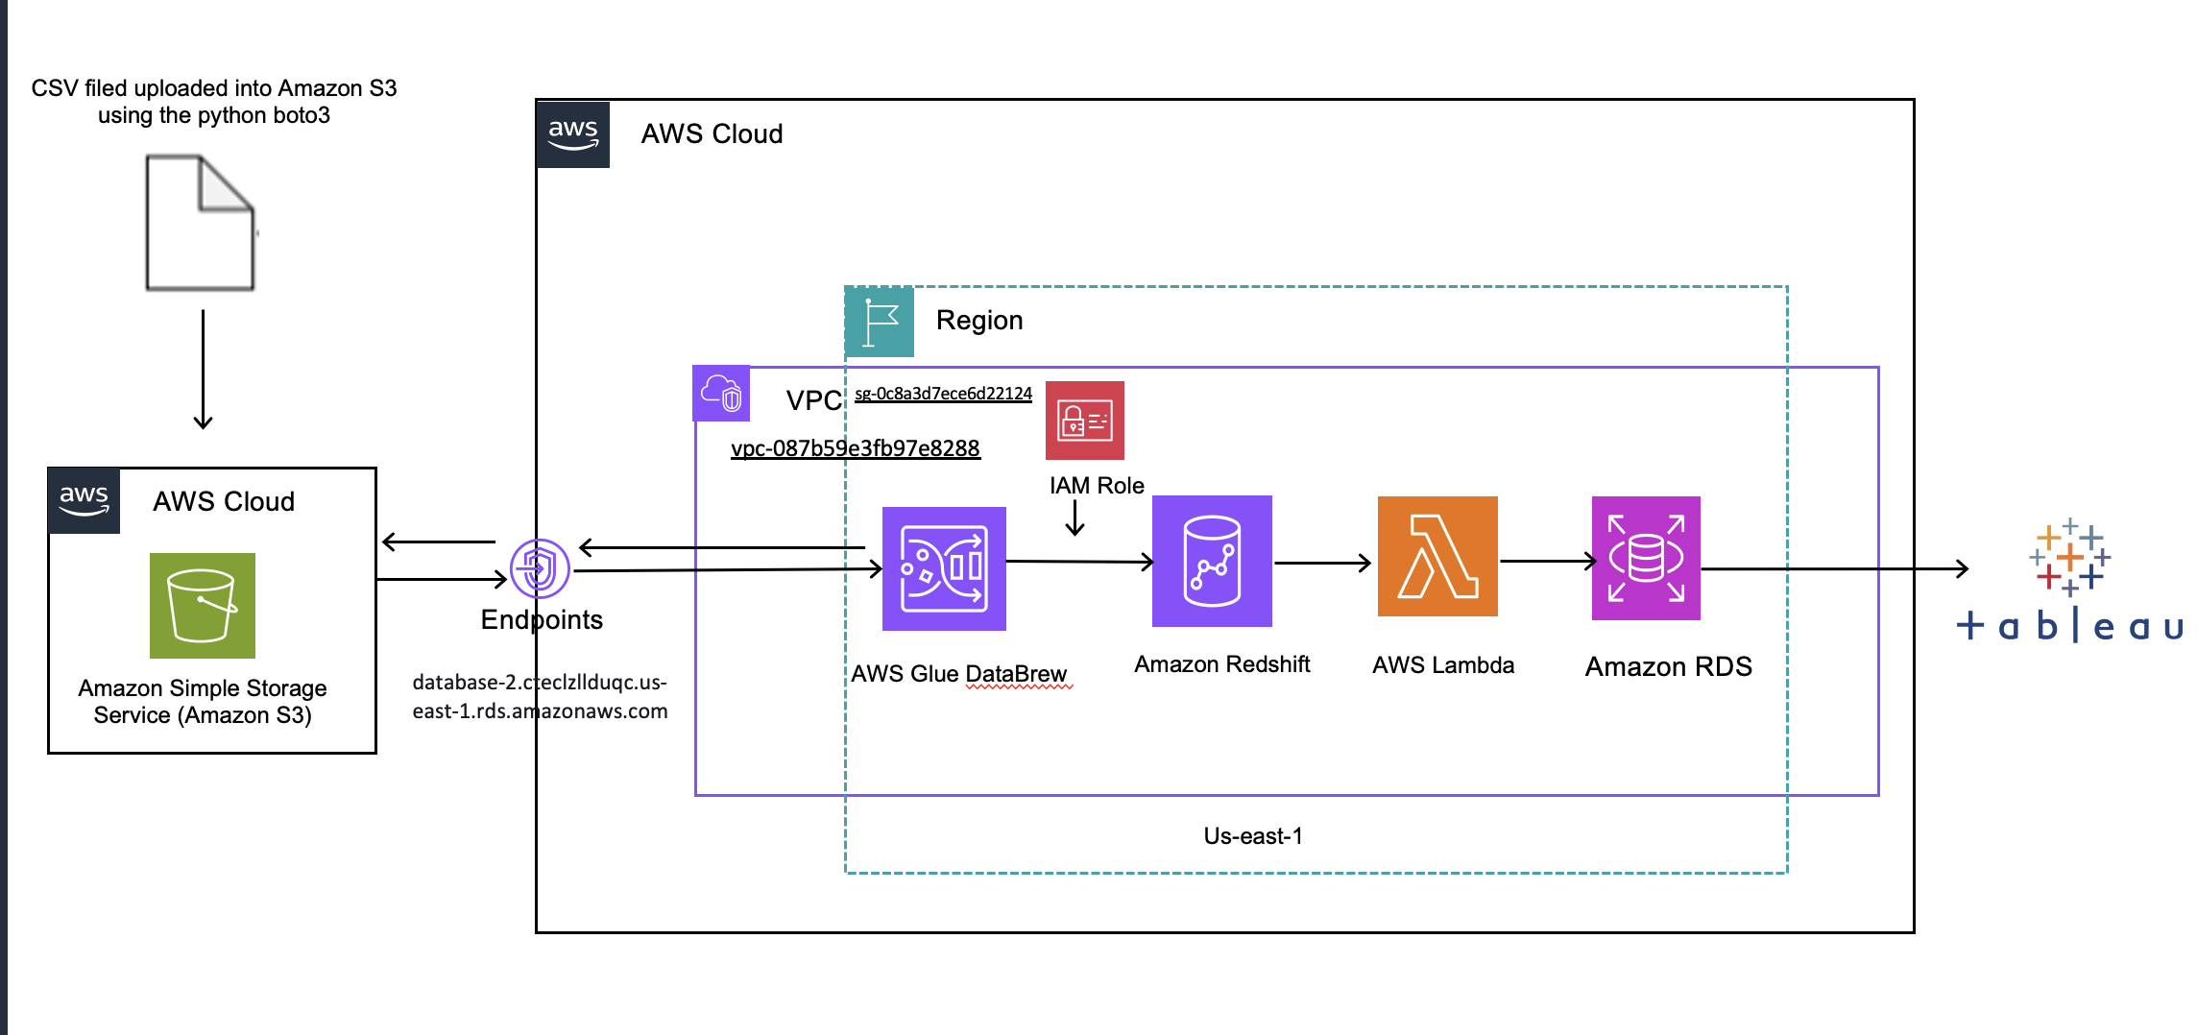
Conceptual Architecture

Slide 10









DEMO

Slide 11
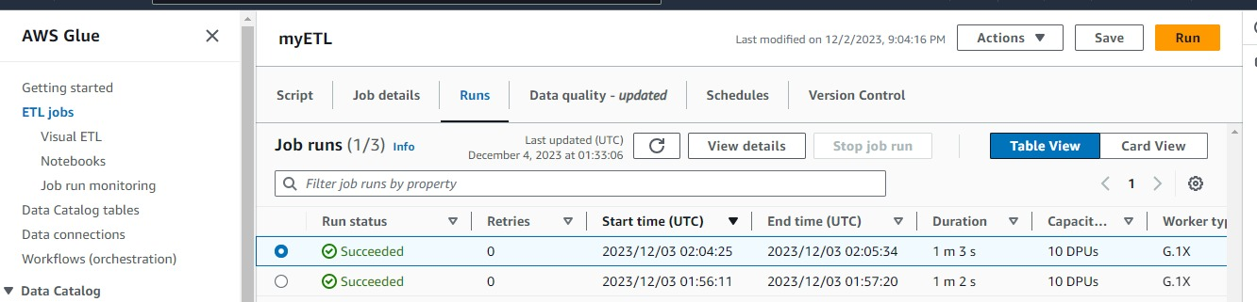
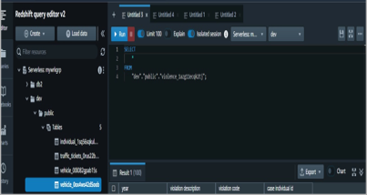

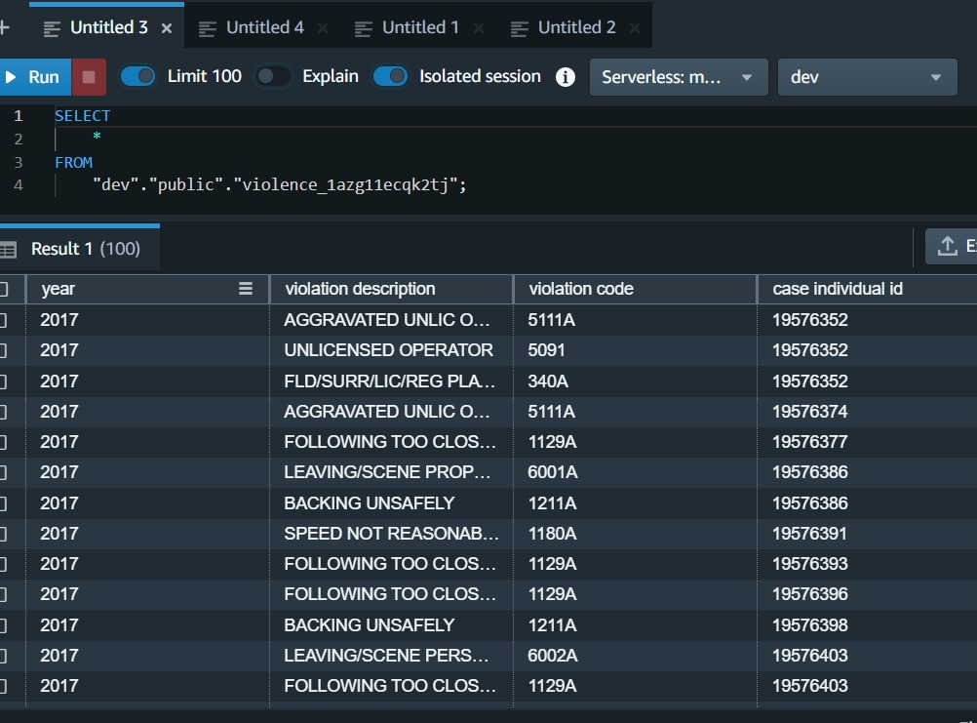
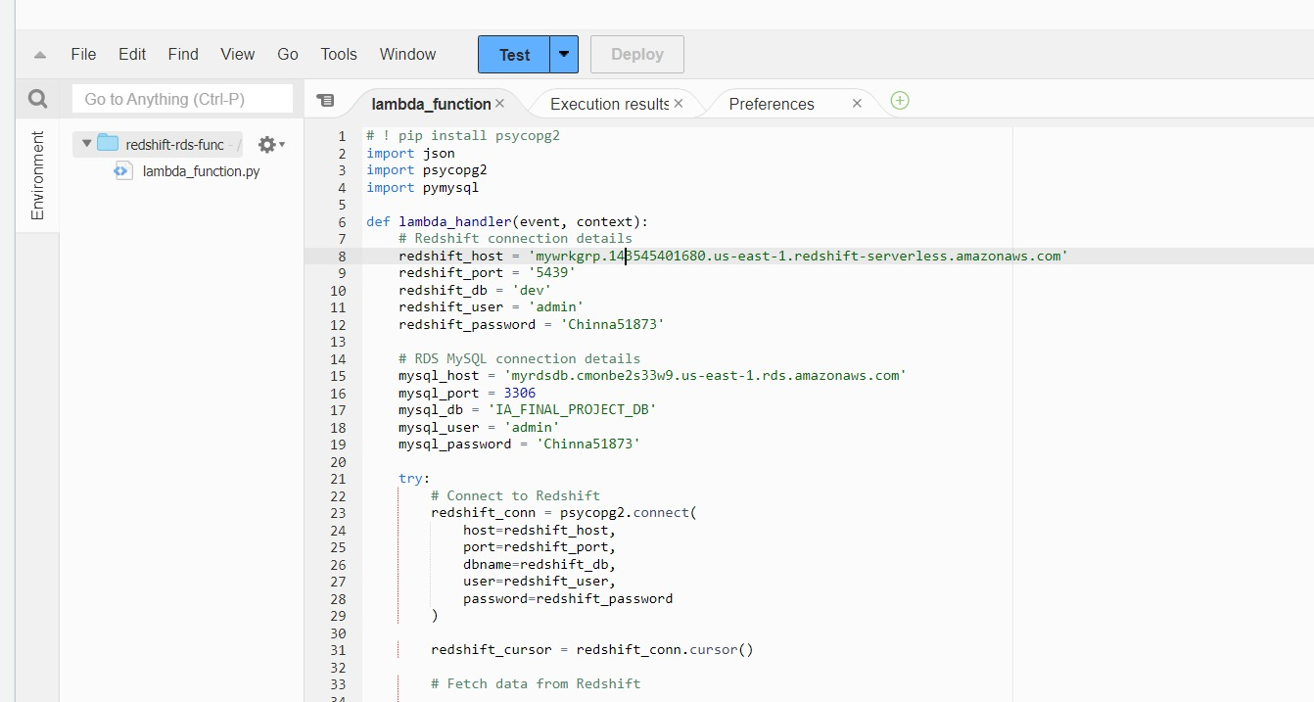

ETL Jobs run to migrate data from s3 to redshift
Create tables in redshift
Use Lambda to move data to RDS MySQL
Redshift query editor

Slide 12
Migrated data from s3 to redshift

Slide 13
Run a query in redshift query editor to check data

Slide 14
Using Lambda function to move data from redshift to RDS MYSQL

Slide 15
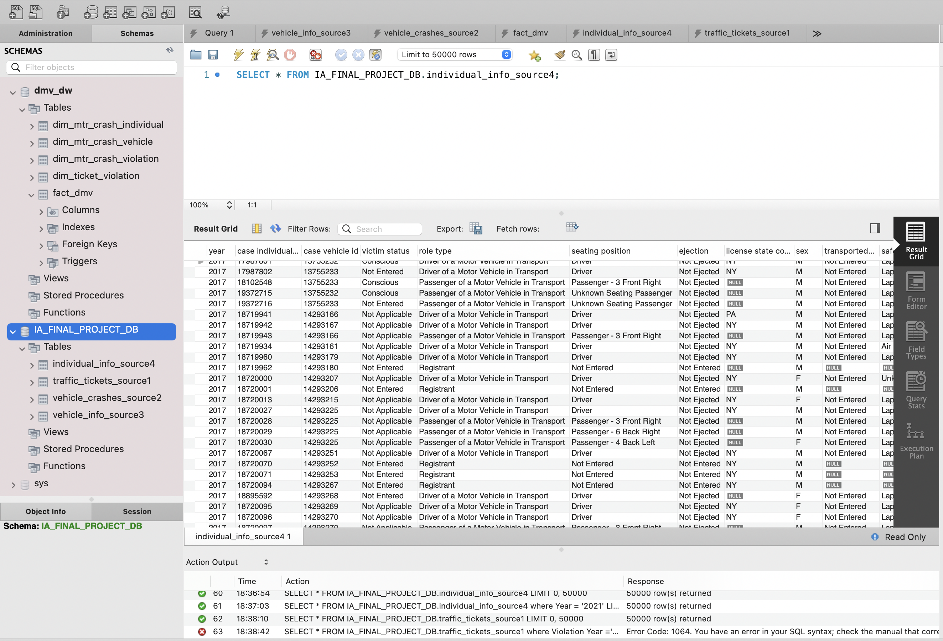
Data loaded in RDS MySQL

Slide 16
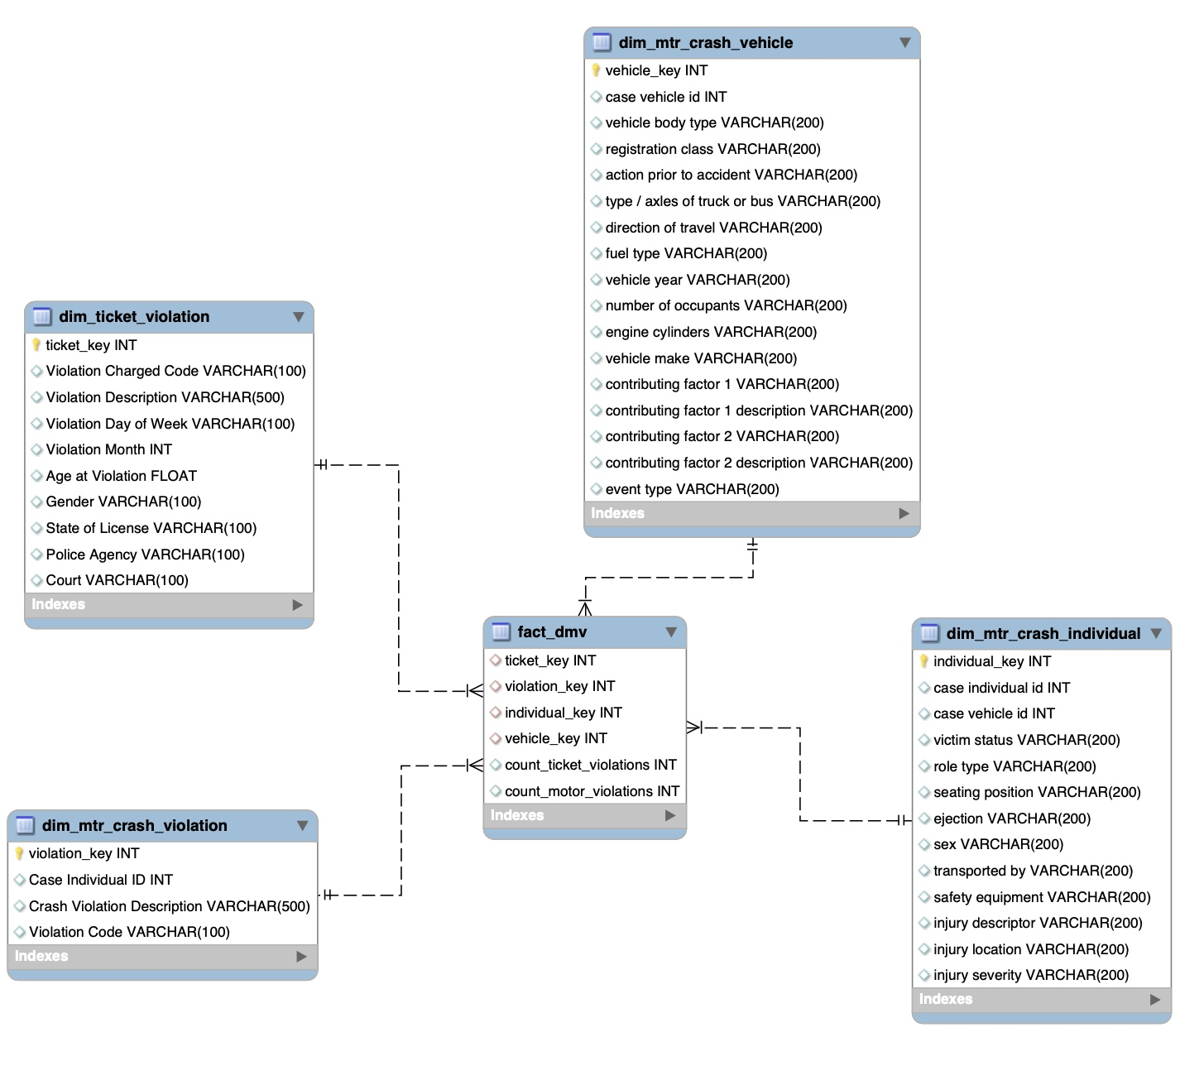
OLAP ERD

Slide 17
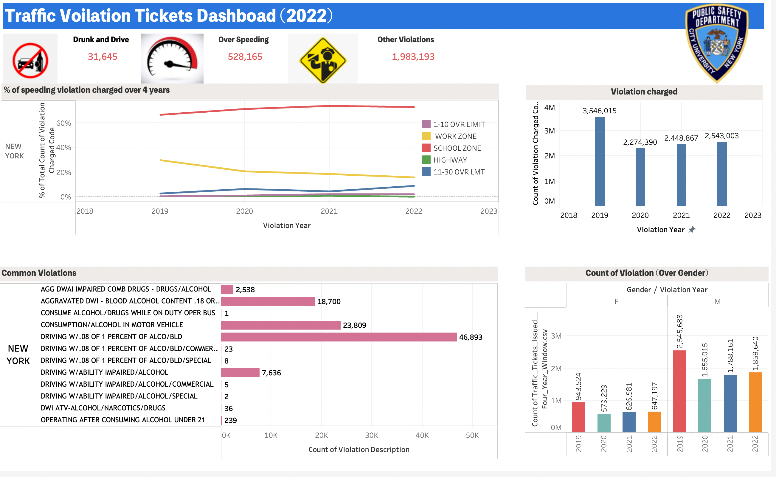

Slide 18
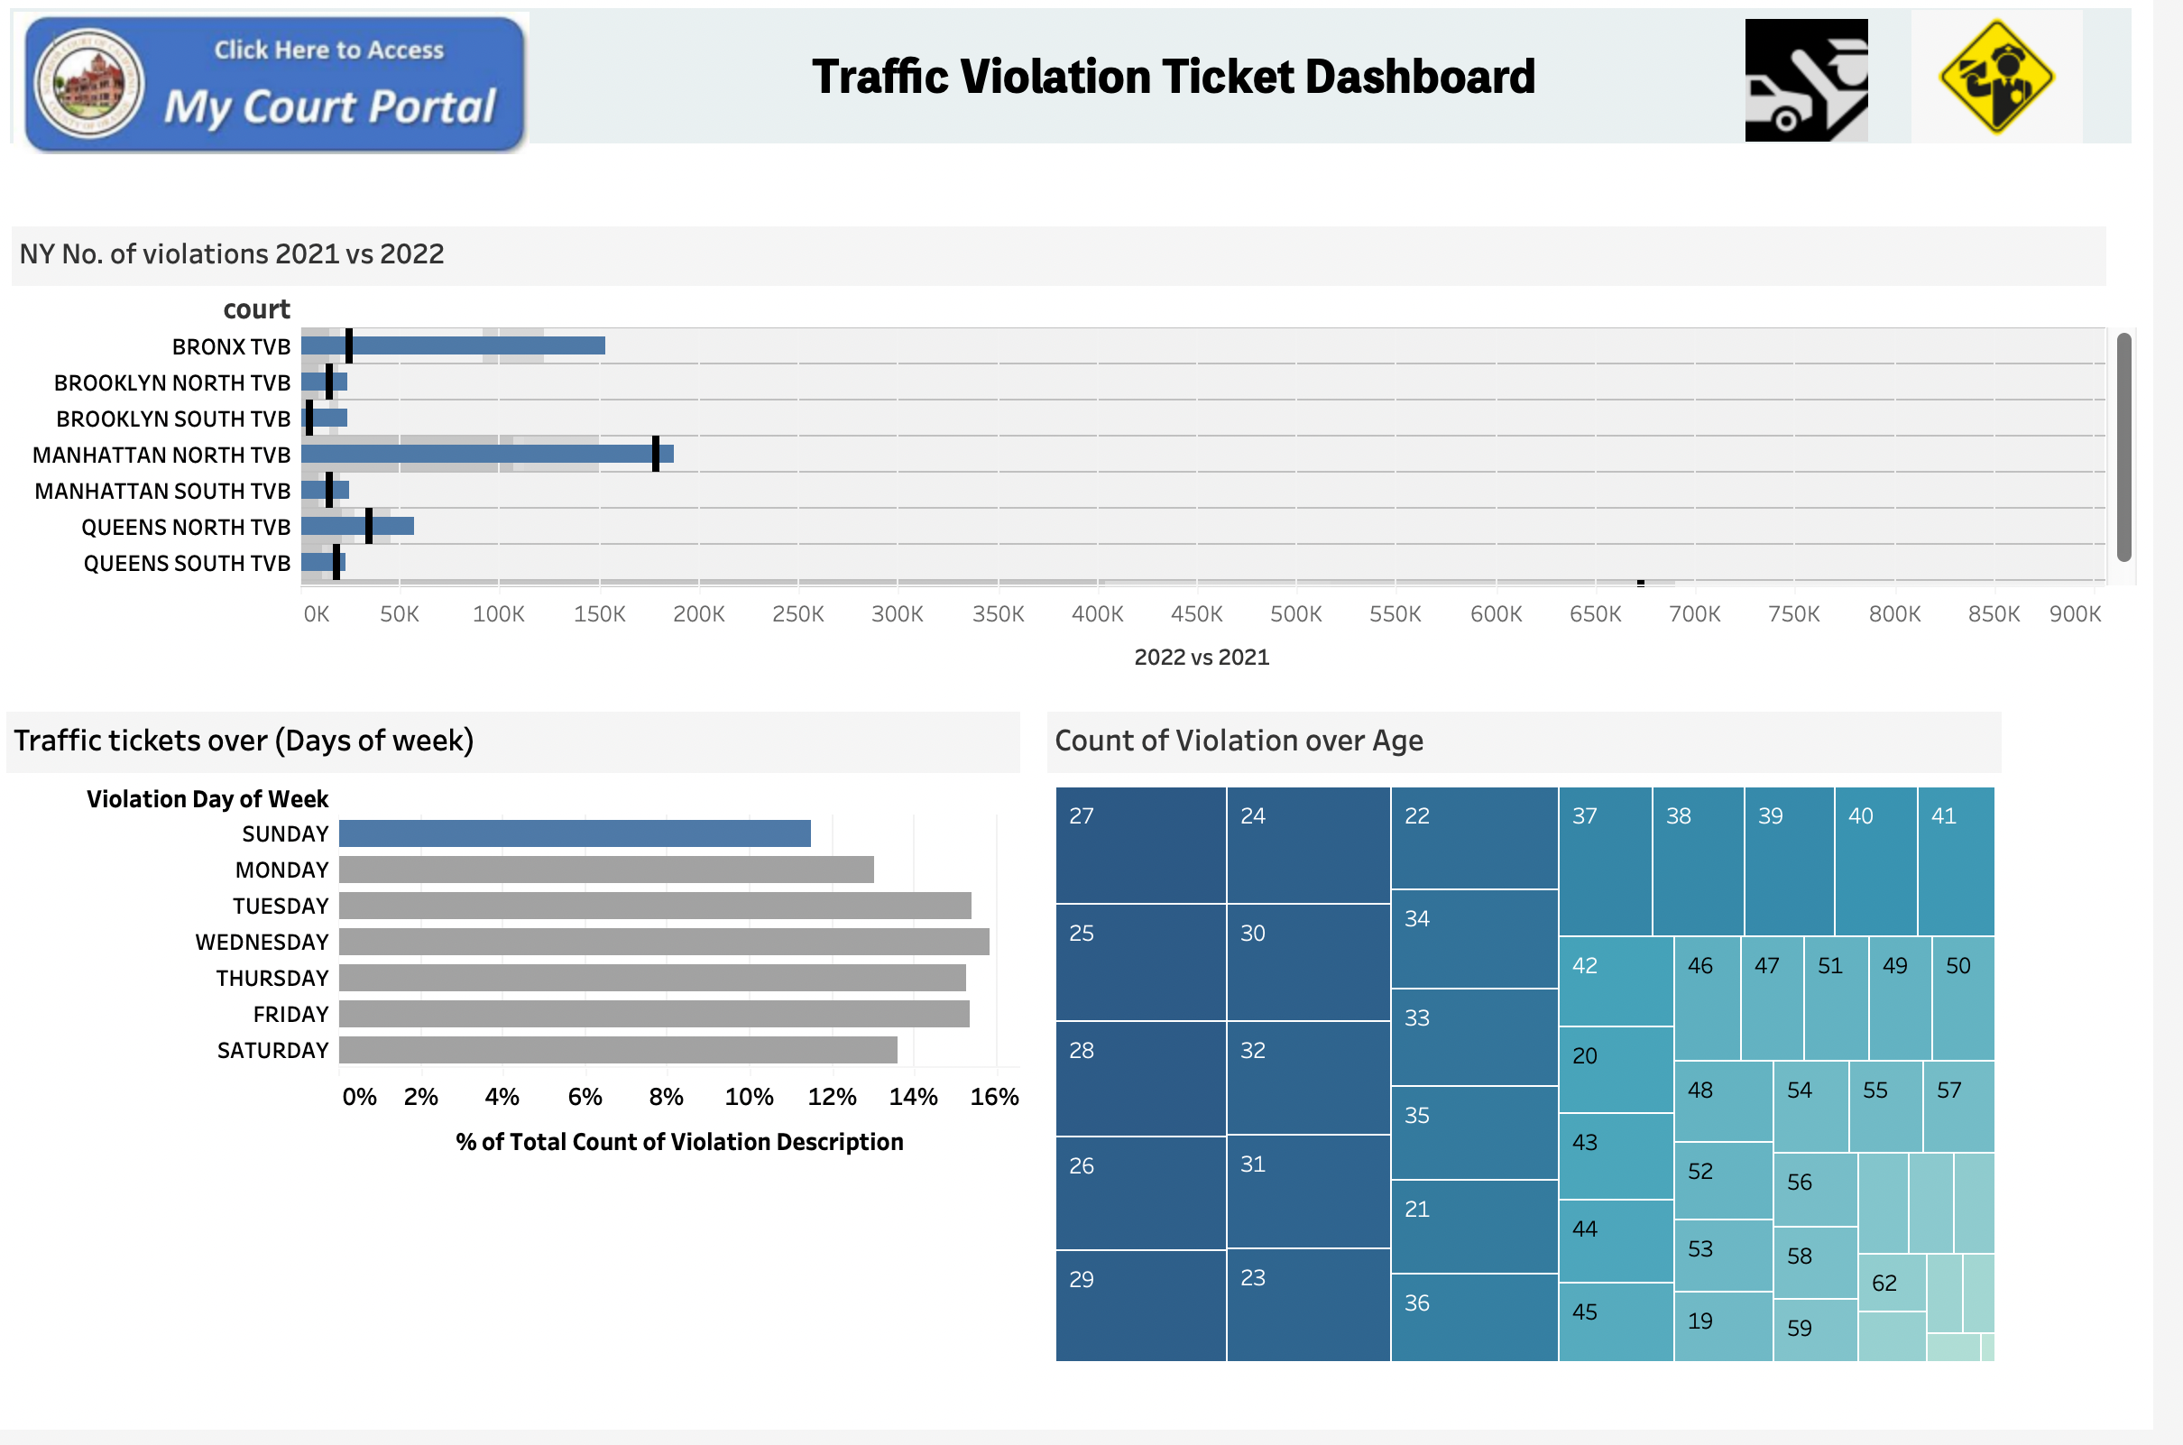

Slide 19





Project Milestones & Timeline
Week 4-7
Week 13-15
Identify Business Needs
Identify, gather and analyze the business requirements.
Development
Develop conceptual, logical, and physical data model to achieve the ultimate warehouse solution.
Deliver & Present
Present final solution to class
Determine peer score.
Design and Planning
Plan and design of the deliverables for the data warehouse solution.
Analyze, Visualize & Test
Analyze the data, gain insights and use visualizations to help understand the data better and test the assumptions.
Week 1-3
Week 8-12
Week 16

Slide 20
Team Responsibilities
Ashish Bachuwar
GROUP 2
Finding and profiling the dataset
Some tasks in Design and Planning phase
Responsible for architecting the framework for the project
Worked together in preparing the executive presentation
Minjae Lee
Mahanth Dasari
Some aspects of designing and planning
Overseeing the development phase
Responsible for some aspects of the development phase
Worked together in preparing the executive presentation
Responsible for some aspects of the development phase
Responsible for the visualization aspect
Worked together in preparing the executive presentation

Slide 21

Assumptions
1
2
Data from traffic violation and crash records is accurate and complete.
Analyzed data is representative of all traffic violations in NYC.
3
4
Correlations between violations and crashes imply causation.
Insights directly inform policymaking and law enforcement.

Slide 22

Challenges
Data Quality:
Challenge: Ensuring accuracy and completeness of the traffic violation and crash datasets.
Why: Inaccurate or incomplete data may lead to flawed insights and hinder effective decision-making.
1
Representativeness Bias:
Challenge: Ensuring the analyzed data represents the diversity of all traffic violations in NYC.
Why: Biases in demographic or geographic representation may limit the generalizability of findings.
2
Causation Inference:
Challenge: Distinguishing correlation from causation in identifying patterns.
Why: Assuming direct causal links without considering other influencing factors may lead to misguided strategies.
3

Slide 23

Lessons Learned
The following are the key lessons learned from the project.
Validate Data Rigorously
Conduct robust data validation and cleaning procedures to ensure accuracy and completeness.
Enhance Data Diversity
Strive for a more inclusive dataset to better represent diverse demographics and geographical areas.
Acknowledge Causation Complexity
Clearly communicate the complexity of causation, involve domain experts, and explore alternative explanations.
Align with Real-world Constraints
Engage policymakers early, considering budget, legal, and practical constraints for feasible and impactful strategy implementation.

Slide 24
THANK YOU

